Slide 1
ICS 491 Big Data Analytics
Fall 2017
Deep Learning
Assoc. Prof. Lipyeow Lim
Information & Computer Sciences
University of Hawai`i at Manoa

Slide 2
Single Perceptron
x^{T} = [ x₁ x₂ … x_{n} ]
w^{T} = [ w₁ w₂ … w_{n} ]
h = a(x^{T}w)
If activation function is
rectified linear, a(i) = max(0,i)
Sigmoid, a(i) = 1/(1+e^{-i})
x₁
w₁
x₂
w₂
a
h
:
:
w_{n}
x_{n}
Bias can be incorporated either as an additional weight with a 1-input or explicitly
h = a(x^{T}w + b)

Slide 3
Multiple Perceptron
x^{T} = [ x₁ x₂ … x_{n} ]
W = [ w_{1,1} … w_{k,1} ]
[ w_{1,2} … w_{k,2} ]
[ … … … ]
[ w_{1,n} … w_{k,n} ]
Vector h = a(x^{T}W)
assume activation function is applied to each element of vector
x₁
w_{1,1}
w_{1,2}
a₁
h₁
x₂
w_{1,n}
:
:
w_{k,1}
:
:
w_{k,2}
a_{k}
h_{k}
w_{k,n}
x_{n}
For notational convenience, also possible to formulate as
h = a(W^{T}x)

Slide 4
Multiple-Layer Perceptron
x^{T} = [ x₁ x₂ … x_{n} ]
W₁=[ w_{1,1,1} … w_{1,k,1} ]
[ w_{1,1,2} … w_{1,k,2} ]
[ … …… ]
[ w_{1,1,n} … w_{1,k,,n} ]
h₁ = a(x^{T}W₁)
h₂ = a(h^{T}W₂)
x₁
w_{1,1,1}
w_{1,1,2}
w_{2,1,1}
a_{1,1}
h_{1,1}
x₂
w_{1,1,n}
:
:
a_{2,1}
h_{2,1}
w_{1,k,1}
:
:
w_{1,k,2}
a_{1,k}
h_{1,k}
w_{2,1,n}
w_{1,k,n}
x_{n}
W₁
W₂
x
a
h₁
a
h₂
Compressed Representation

Slide 5
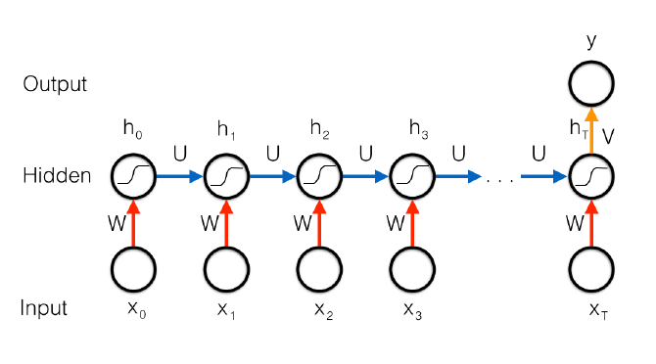
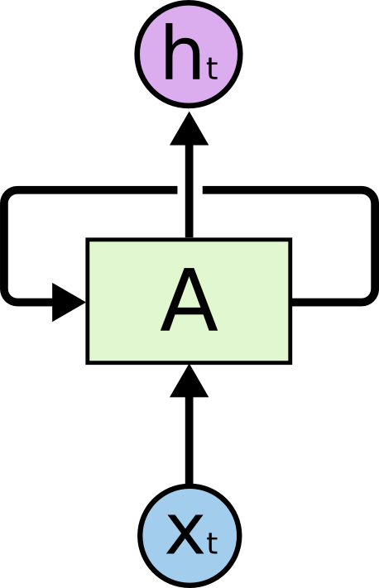
Recurrent Neural Networks
Unroll over time
Modeling time-series data or data with sequential dependencies (eg. text/language).
Feed previous “state of network” as additional input to current network

Slide 6
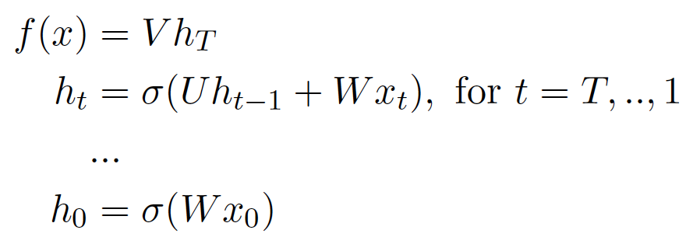
RNN Equations
Hidden to output weights
Regular NN weights
What happens when you do gradient descent and back propagation?
Recurrent loop weights

Slide 7
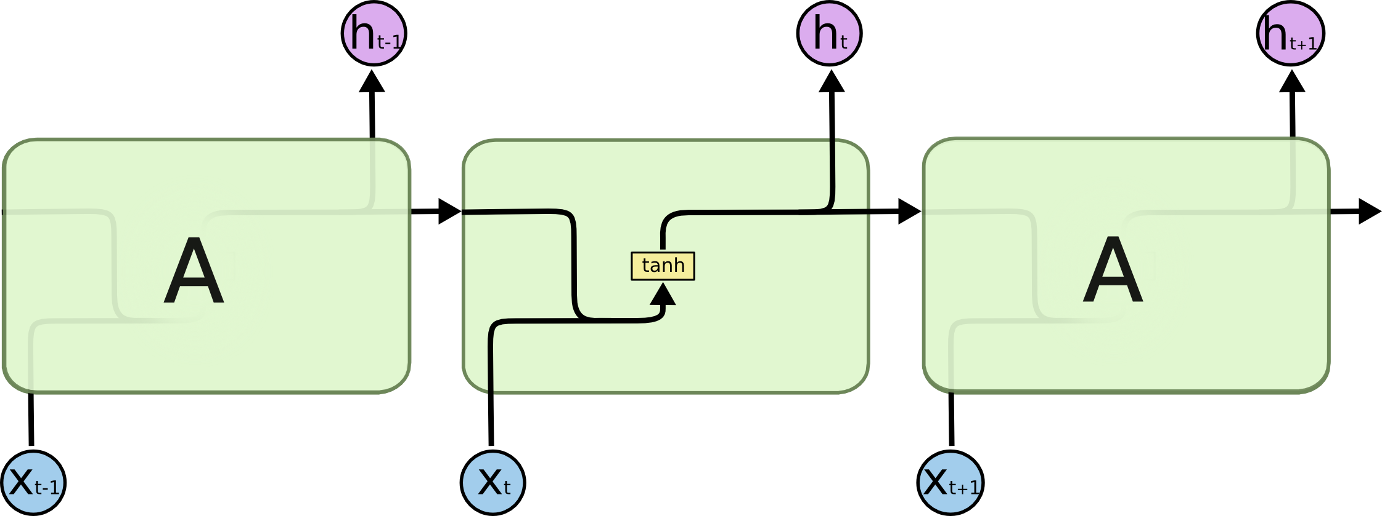
RNN to LSTM
Persisting “memory” this way with backpropagation is problematic!
Adapted from : http://colah.github.io/posts/2015-08-Understanding-LSTMs/

Slide 8
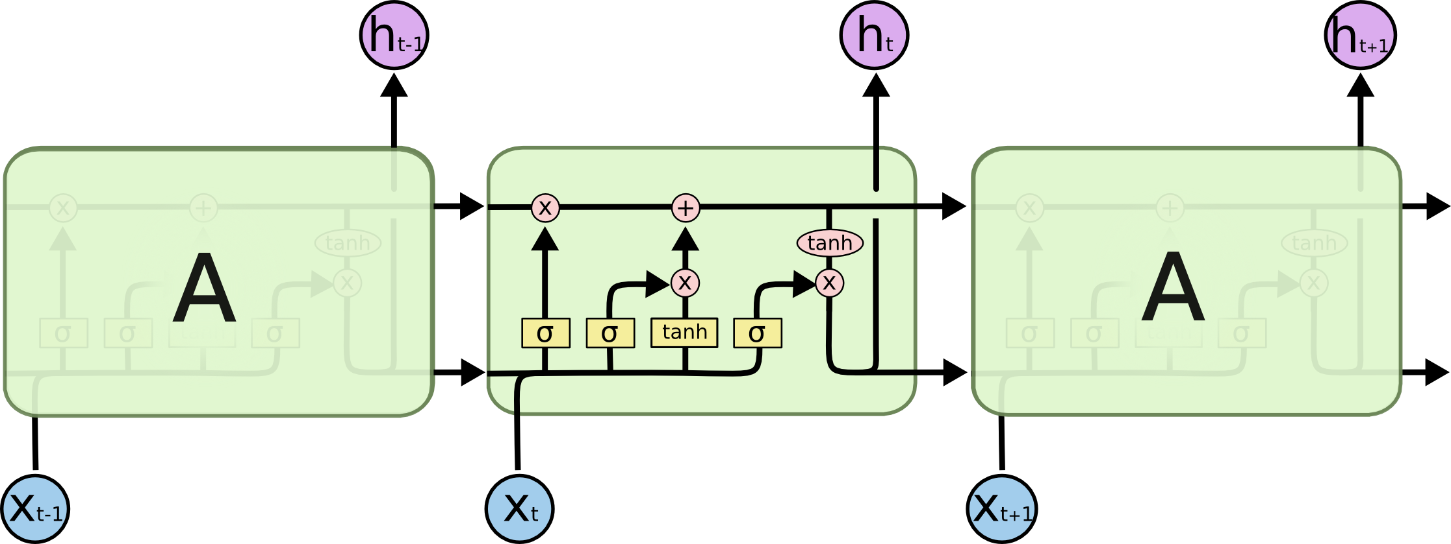
Long Short Term Memory (LSTM)

Slide 9
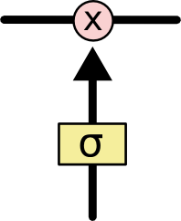
Cell States & Memory Gates

Slide 10
Step 1: Forget Gate Layer

Slide 11
Step 2: Compute new Cell State

Slide 12
Step 3: How much of cell state to propagate

Slide 13
Step 4: Compute output of this time step

Slide 14
Variant : Peep Hole Connections

Slide 15
Variant: couple forget & input together

Slide 16
Variant: Gated Recurrent Units (GRU)

Slide 17
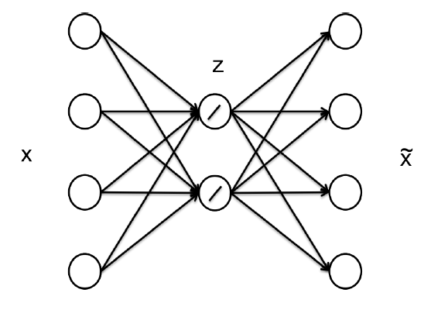
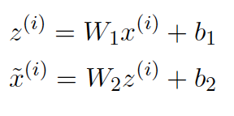
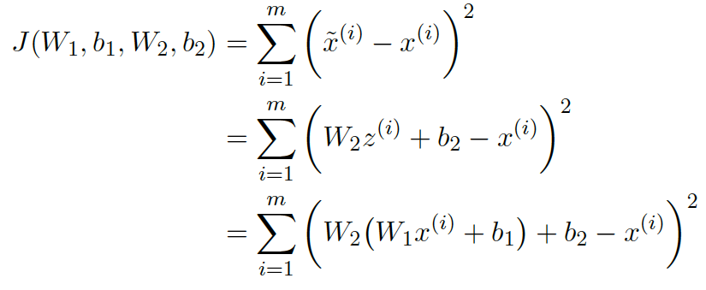
Unsupervised Learning with Auto-encoders
Objective is to minimize reconstruction error
Input data
Compressed Representation
Reconstruction

Slide 18
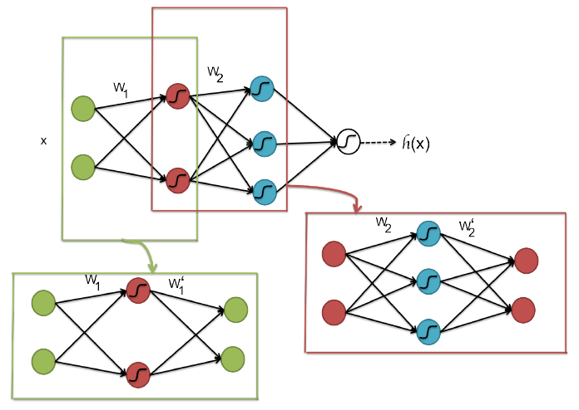
Auto-encoder for initializing deep networks
Pretraining step: train a sequence of shallow autoencoders, greedily one layer at a time, using unsupervised data,
Fine-tuning step 1: train the last layer using supervised data,
Fine-tuning step 2: use backpropagation to ne-tune the entire network using supervised data.
Notes:
The reason is that training very deep neural networks is difficult:
The magnitudes of gradients in the lower layers and in higher layers are different,
The landscape or curvature of the objective function is difficult for stochastic gradient descent to find a good local optimum,
Deep networks have many parameters, which can remember training data and do not generalize well.

Slide 19
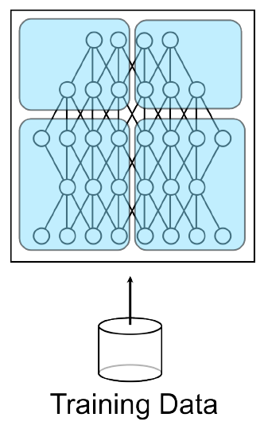
Parallel Processing for Neural Networks
Model Parallelism
Neural Network model is too big for one machine
Partition model across multiple machines
What kind of co-ordination is needed?
Data Parallelism
Partition data across multiple machines

Slide 20
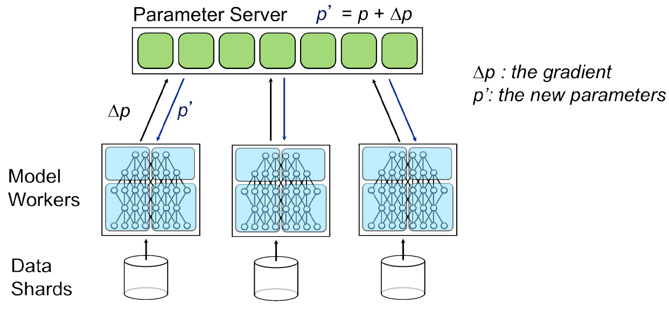
Model + Data Parallelism

